Slide 1
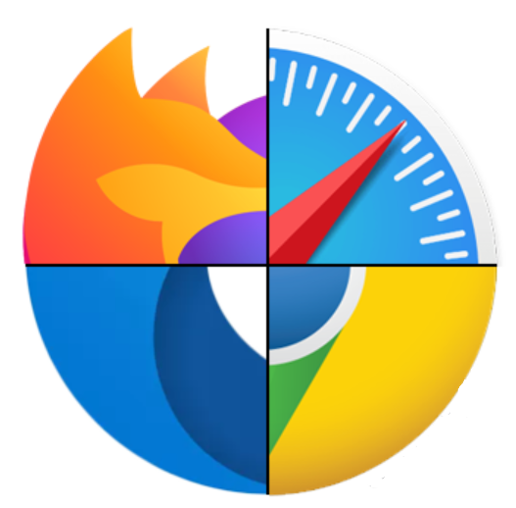
Web Browser
Dr. Muhammad Habib

Slide 2
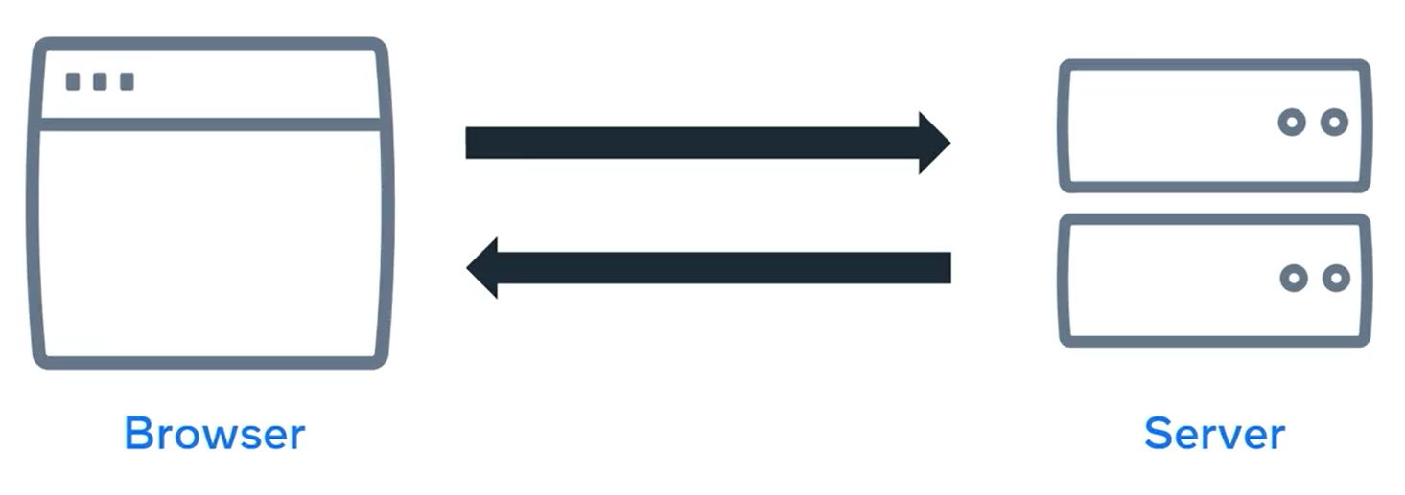
Web Browser
A web browser, or browser for short, is a software application that you use to browse the World Wide Web.
It works by sending a request to a web server and then receives a response containing the content that is to be displayed on the screen of your device.

Slide 3
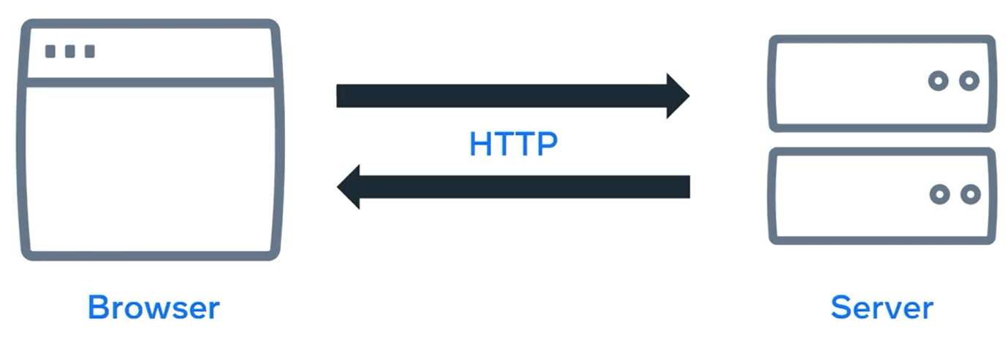
HTTP
When you make a request using this URL, the browser and server communicate using a protocol known as the Hyper text Transfer Protocol or HTTP.

Slide 4
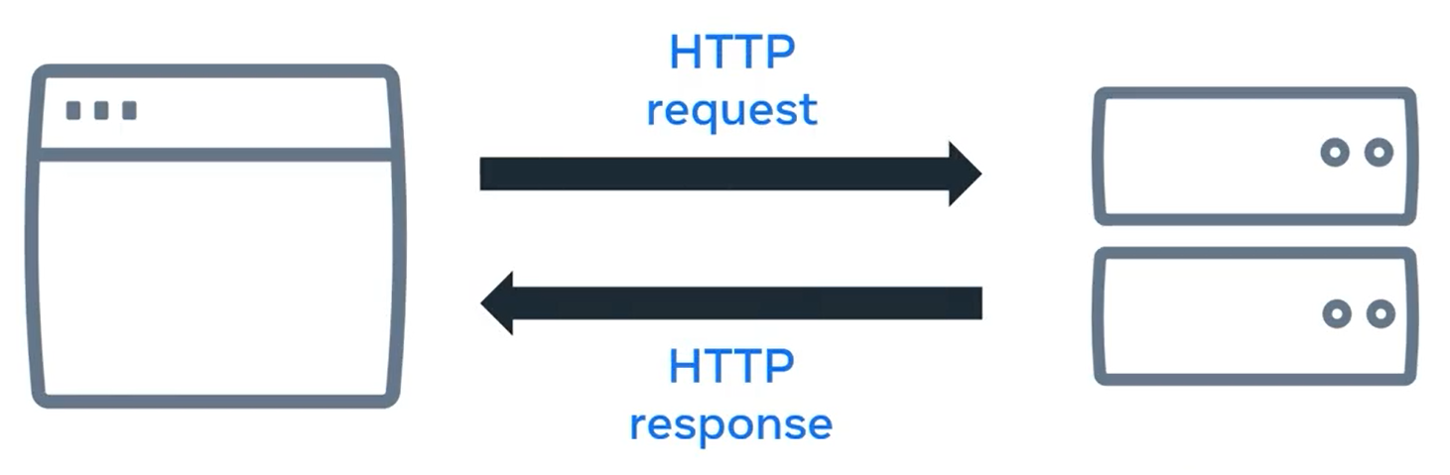
HTTP (Request-Response cycle)
Once the web browser receives the content, it displays it on the screen of your device.
This exchange of information is made possible by something known as the request response cycle.
Now, lets demonstrate this using an example.

Slide 5
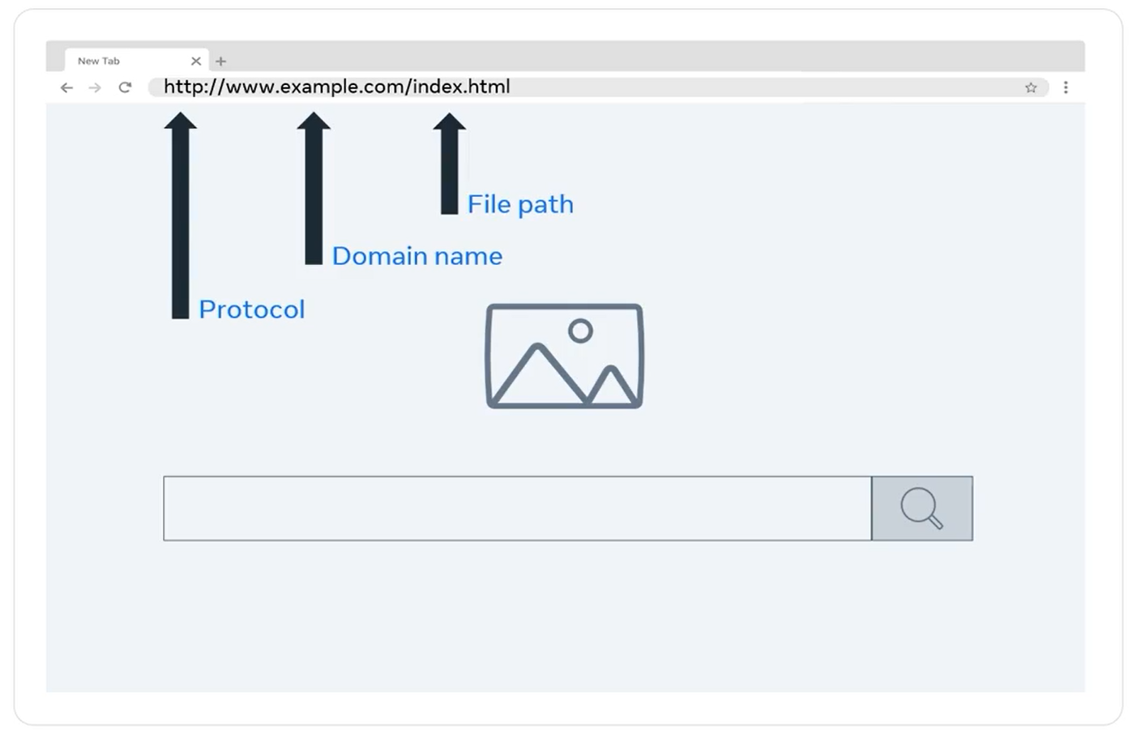
Web Browser

Slide 6
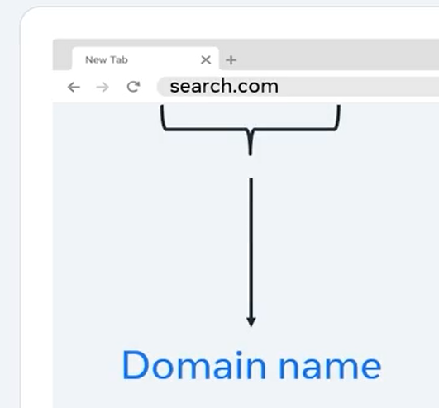
Web Browser
First, open a web browser, which is a software application.
Next, type the name of your favorite search engine.
The name you type contains something called a domain name.

Slide 7
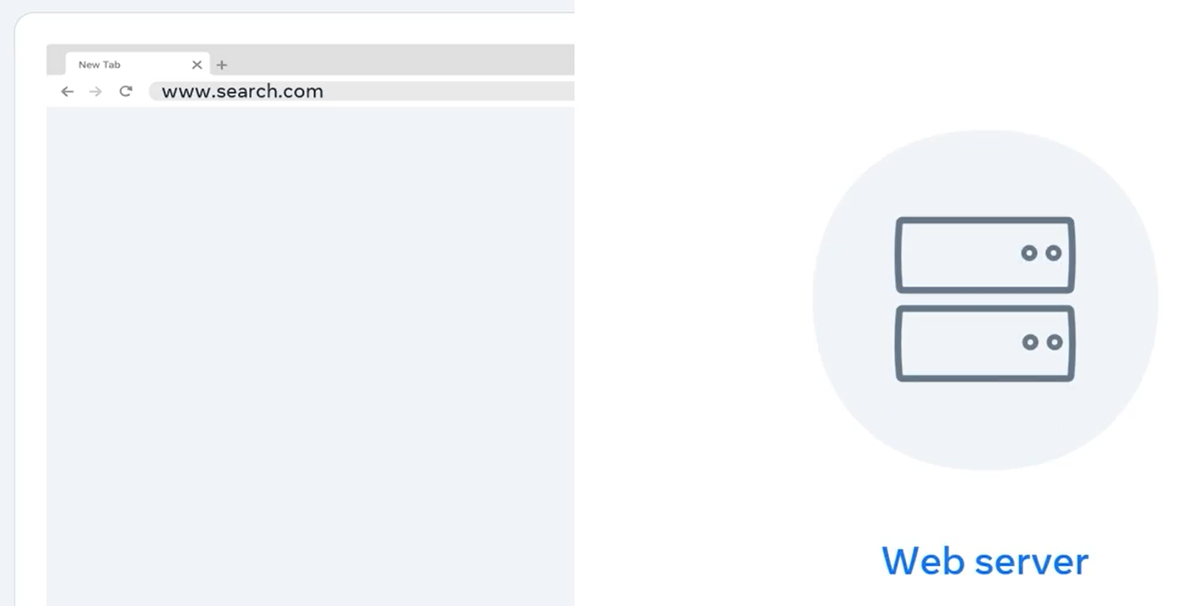
Web Browser
When you press Enter, the web browser sends a request across a network and connects to another computer on the Internet called a web server.

Slide 8
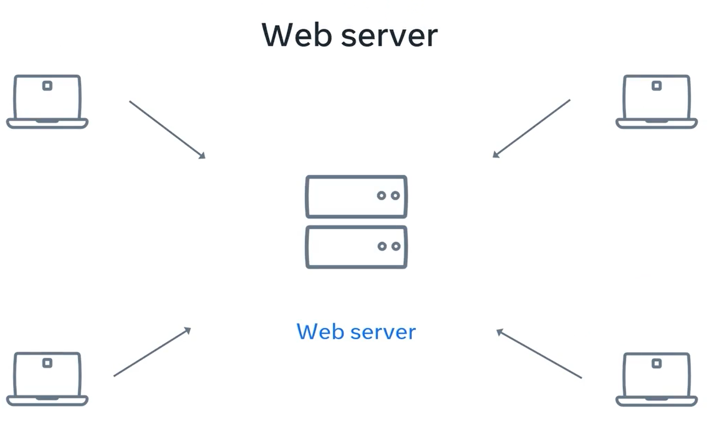
Web Browser
The web server is a special type of computer that allows other computers to make requests for data.

Slide 9
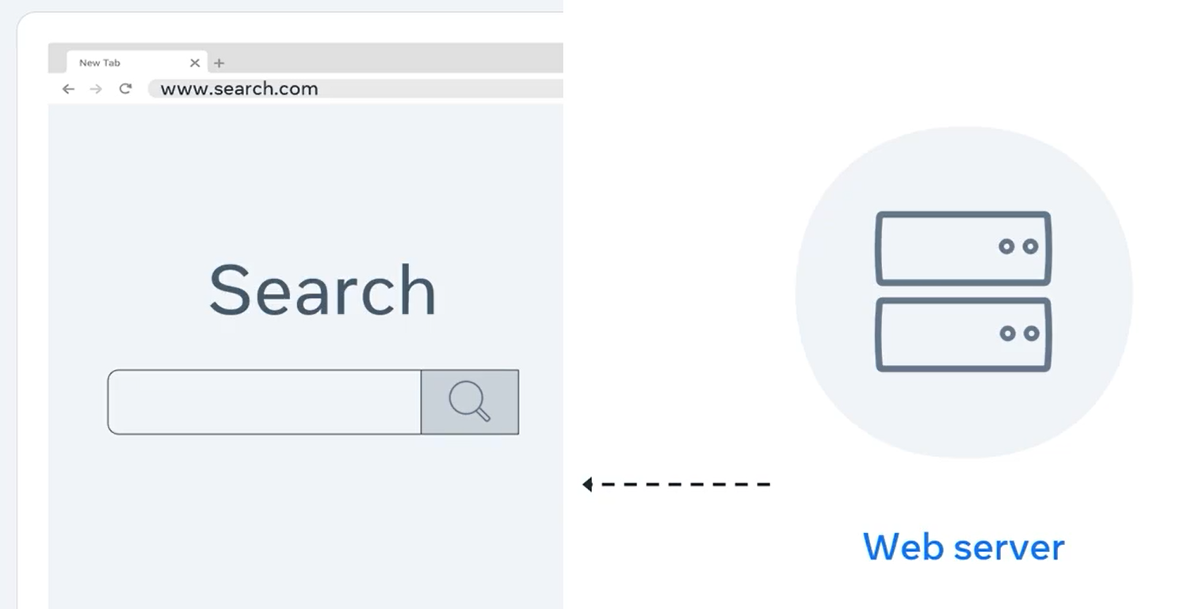
Web Browser
The web server responds by sending a webpage back to the browser.
Once the browser receives all the response information, the search engine webpage is made visible.

Slide 10
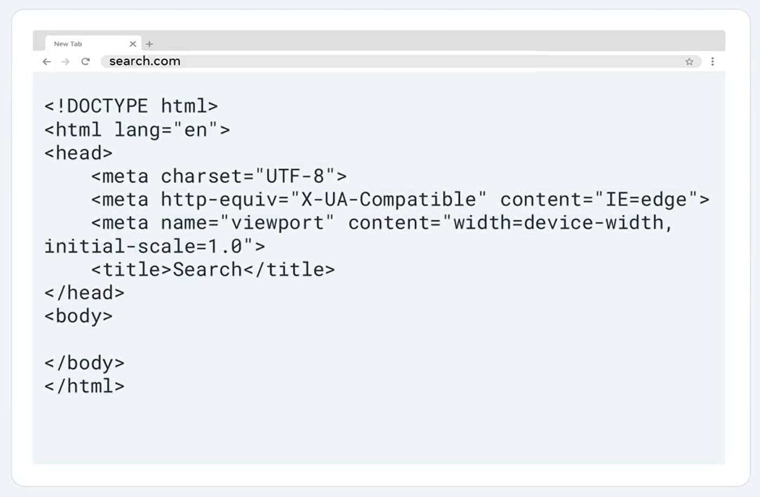
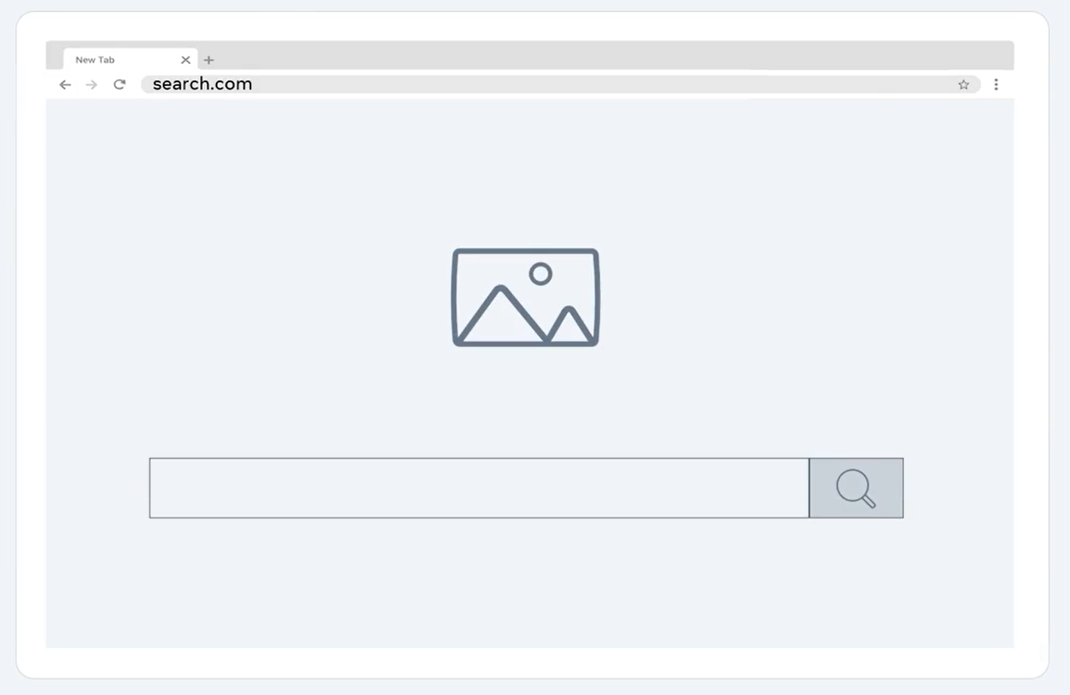
Web Browser
The web page is a coded document that is rendered by the browser and then presented visually to you, the end-user.

Slide 11
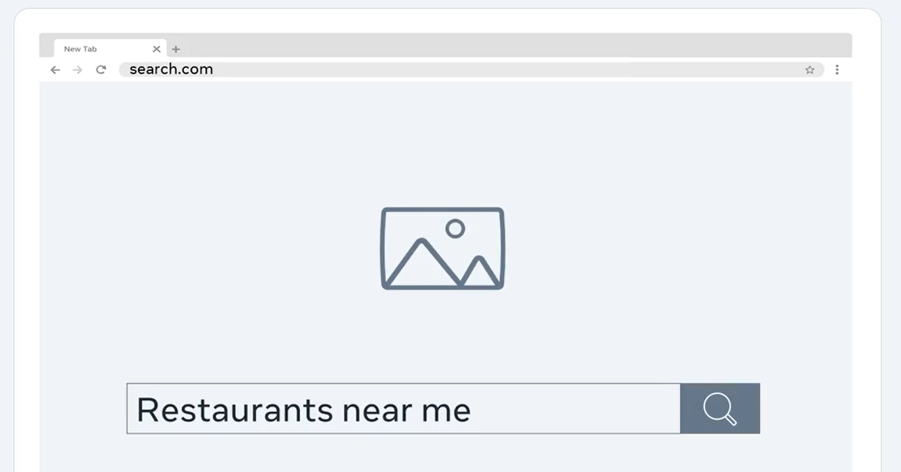
Web Browser
Now that the search engine webpage is loaded in the browser, you interact with that page to search for what you want to find.
For example, type restaurants near me in the search bar and press the search button.

Slide 12
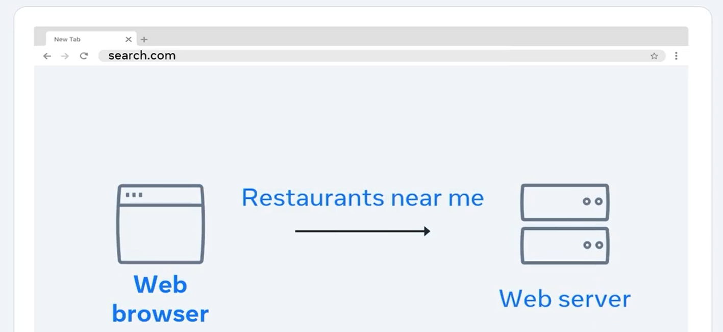
Web Browser
Once again, the browser prepares and sends a request to the same search engine web server.
This time, the request contains the added instructions to search for the phrase “restaurants near me”.

Slide 13
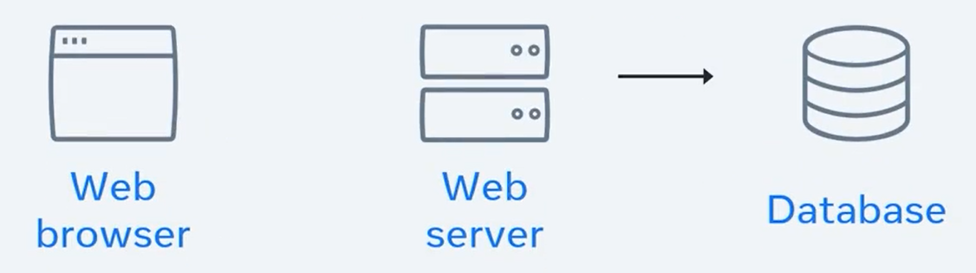
Web Browser
The search engine web server processes the request by taking the keyword and using it to find the requested data.
This data is stored in something called a database, which is connected to the web server.

Slide 14
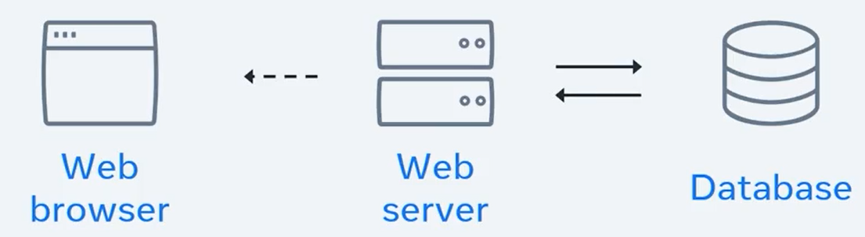
Web Browser
The web server then picks up that data and sends it back to the browser.

Slide 15
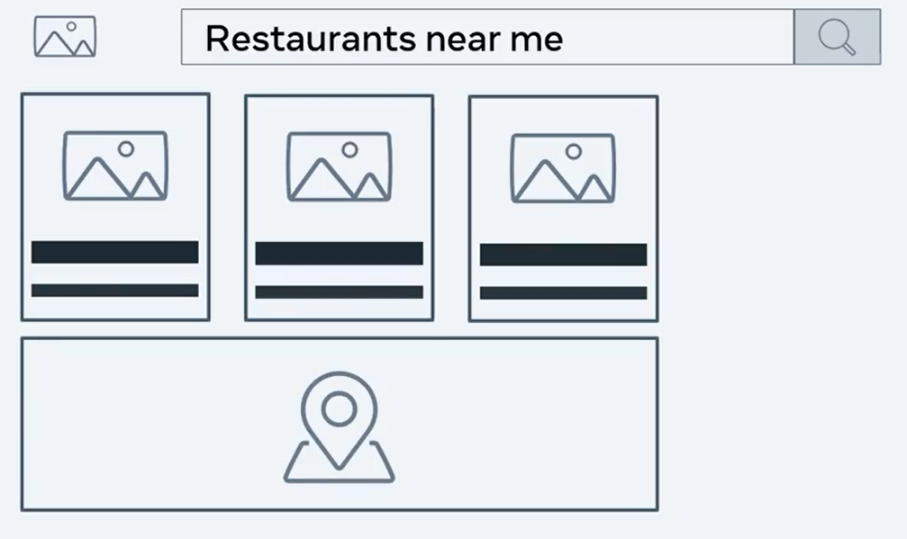
Web Browser
When the web browser receives the full response from the web server, it again renders a visible webpage with links to some restaurants, a map showing near by locations and more related information such as reviews, lists, and even reservations.

Slide 16
Web Browser
Success! This all made possible by computers having a conversation.

Slide 17
Summary
You now learned how the request response cycle works.
This web requests cycle is very similar for a number of other activities we do online, via chatting with friends, watching our favorite movie, or sharing files with our work colleagues.

Slide 18
Additional Resources
Learn more Here is a list of resources that may be helpful as you continue your learning journey.
What is a Web Server? (NGINX)
https://www.nginx.com/resources/glossary/web-server/
What is a Web Browser? (Mozilla)
https://www.mozilla.org/en-US/firefox/browsers/what-is-a-browser/
Who invented the Internet? And why? (Kurzgesagt)
https://youtu.be/21eFwbb48sE
What is Cloud Computing? (Amazon)
https://youtu.be/mxT233EdY5c
Browser Engines (Wikipedia)
https://en.wikipedia.org/wiki/Browser_engine

Slide 19
Thank You

